Slide 1
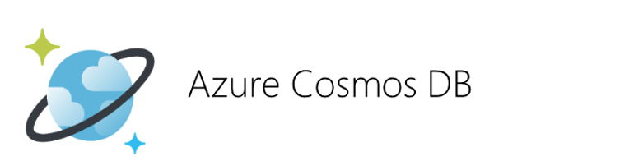
Damir Dobric
daenet Lead Software Architect Microsoft Regional Director Azure MVP
damir.dobric@daenet.com https://about.me/damirdobric

Slide 2
Types of Databases
Relational
SQL Server, Oracle, ..
Graph
Gremlin, AQL, GSQL, SPARQL,..
Document
CouchDB, BaseX, Cloudant, DocumentDB=Core(SQL),..
Key-Value
Dynamo, Berkeley DB, Redis, Memcached,..
Multimodel
Datastax, CosmosDB,..
HBase
Cassandra

Slide 3
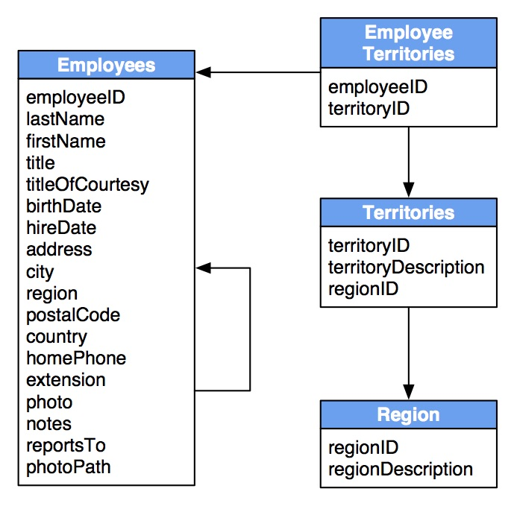
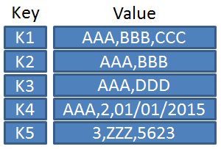
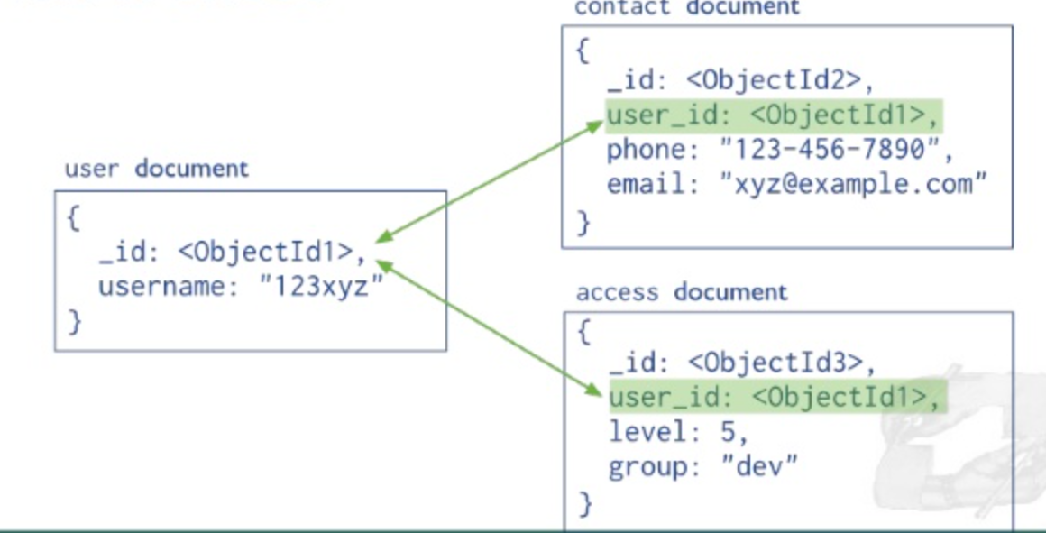
None-Relational
NoSQL
Relational
Key-Value/Table
Document
SQL

Slide 4
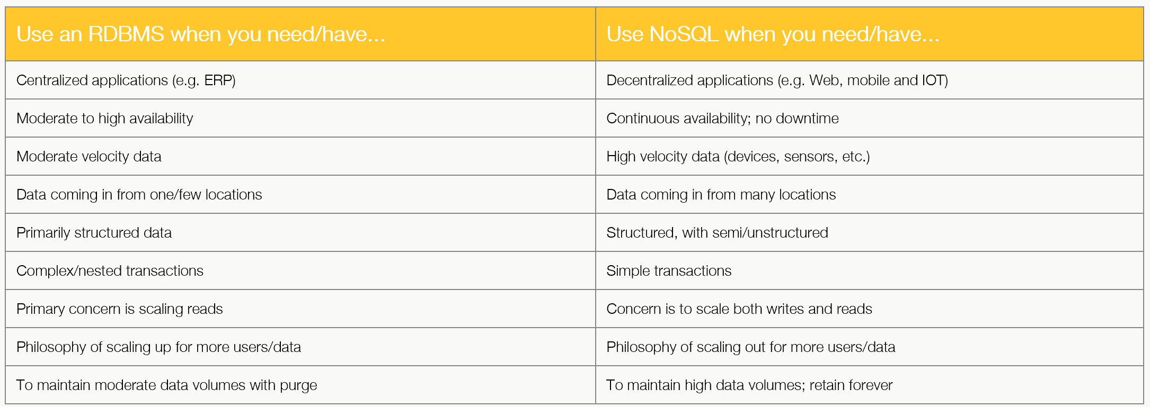
SQLDB vs. NoSQL
https://www.datastax.com/relational-database-to-nosql

Slide 5
DBs in Cosmos DB
SQL
Mongo
Casandra
Azure Table
Graph (gremlin)
Multi API
Endpoint(s)
Endpoint

Slide 6
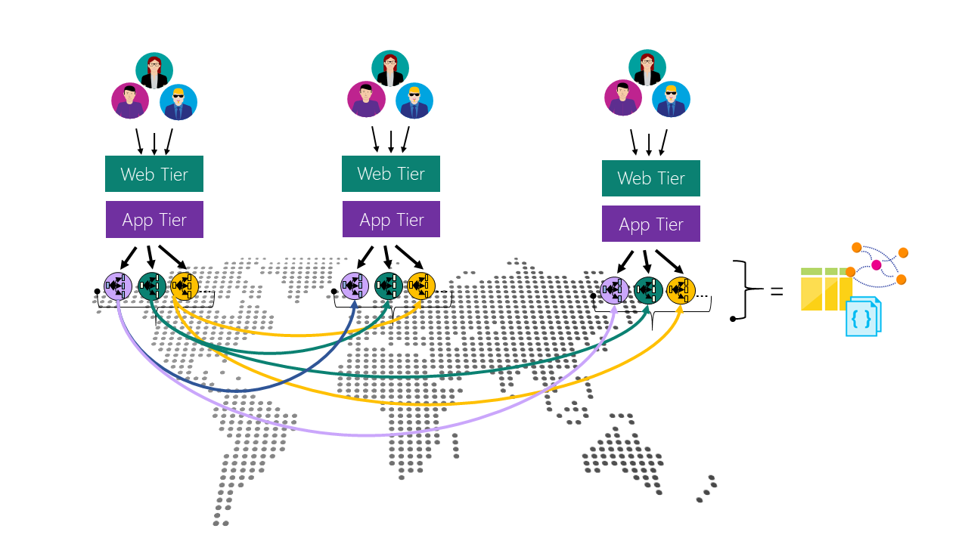
Concept of globally distribution
Unlimited number of regions
Manual failover
Automatic failover
Endpoints
Logical (region agnostic)
Physical (region specific)

Slide 7
DEMO
Create a CosmosDB in Azure

Slide 8
CosmosDB How does it work?

Slide 9
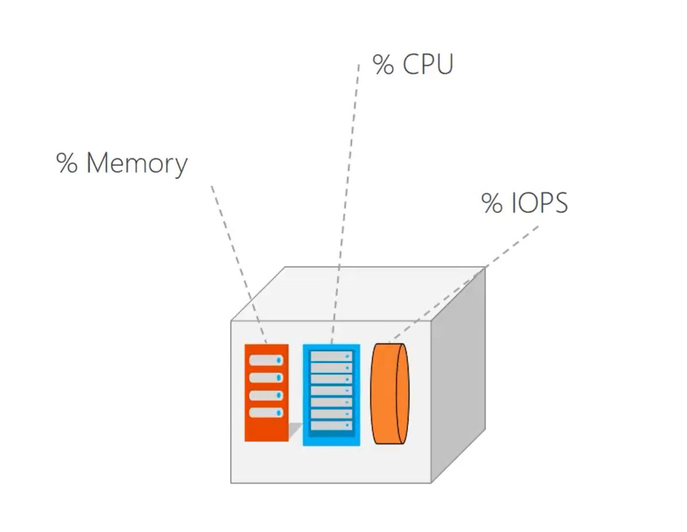
Definition of Request Unit (RU)?
1 RU = 1 read of 1kB record per second
https://docs.microsoft.com/en-us/azure/cosmos-db/request-units

Slide 10
Request Units
RU is amount of computation to serve request
Track it in response header
REST: x-ms-request-charge
SDK: ResourceResponse.RequestCharge
Throughput Limit
HTTP Status 429 Status Line: RequestRateTooLarge x-ms-retry-after-ms :100
SDK: RequestRateTooLargeException
Dokumentation: https://docs.microsoft.com/en-us/azure/cosmos-db/request-units
RU calculator: https://www.documentdb.com/capacityplanner

Slide 11
RUs and Operations
Get
1 RU = get single record of 1k per second
Put/Post (write operations)
Proportional to number of written bytes (1k blocks)
Proportional to number of indexes
Query
Proportional to number of returned bytes (1k blocks)
Proportional to number of query results (generates multiple IOPS)
Billing per hour
Storage + RUs https://azure.microsoft.com/en-us/pricing/details/cosmos-db/

Slide 12
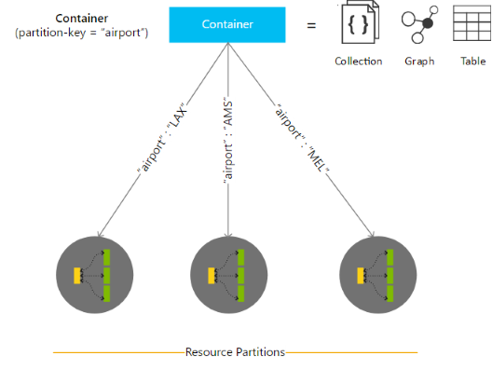
Containers
Container is a logical resource which spans physical partitions
A physical partition is a fixed amount of reserved SSD storage combined with CPU and RAM.
A logical partition is a partition within a physical partition that stores all the data associated with a single partition key. Max = 20 GB
https://learn.microsoft.com/en-us/azure/cosmos-db/partitioning-overview

Slide 13
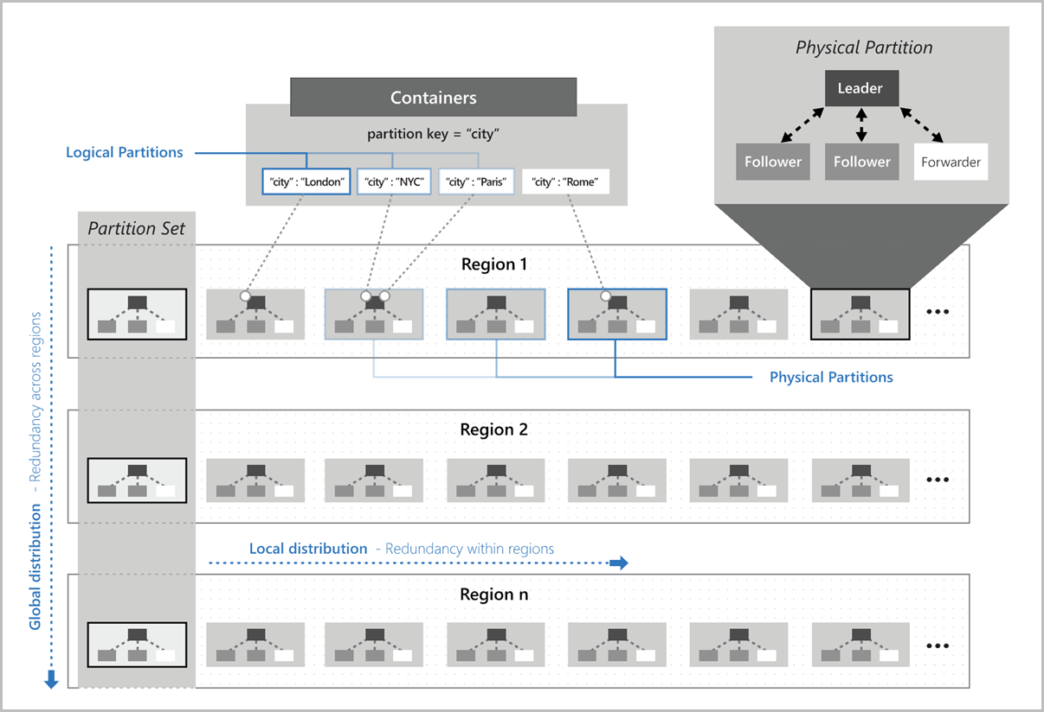
Partitions
https://docs.microsoft.com/en-us/azure/cosmos-db/global-dist-under-the-hood

Slide 14
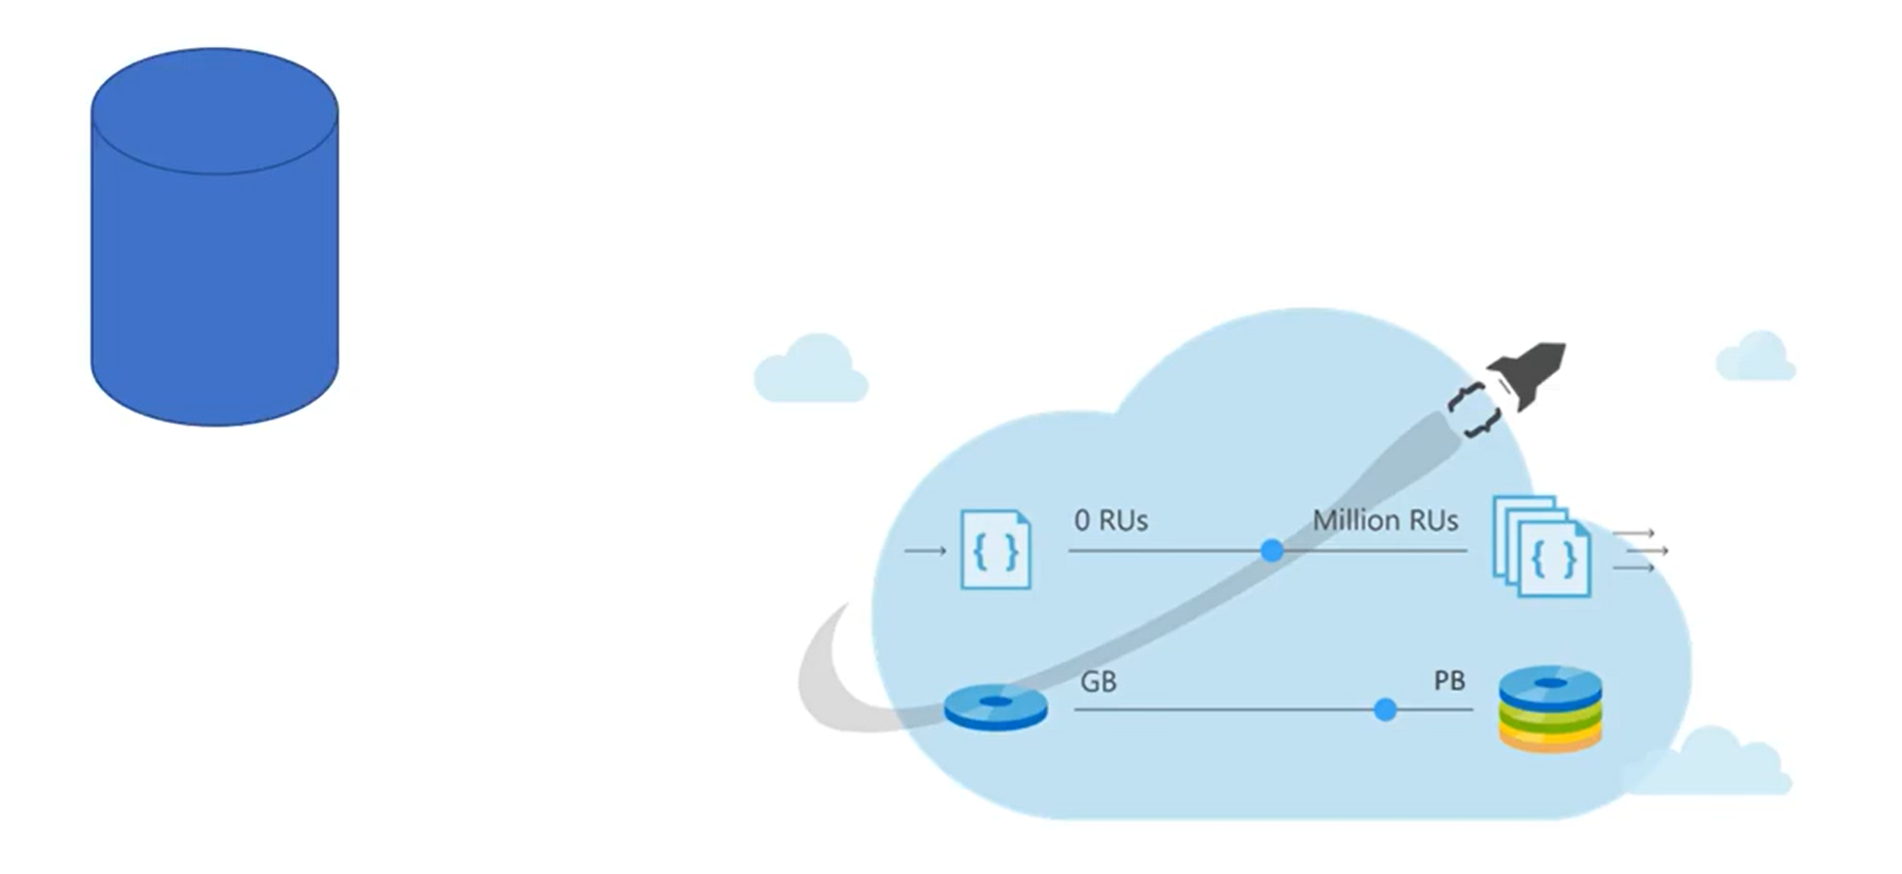
Partitions and Scale
Container=>Scale Unit
Collection (former DocumentDB)
Graph
Table
Mongo

Slide 15
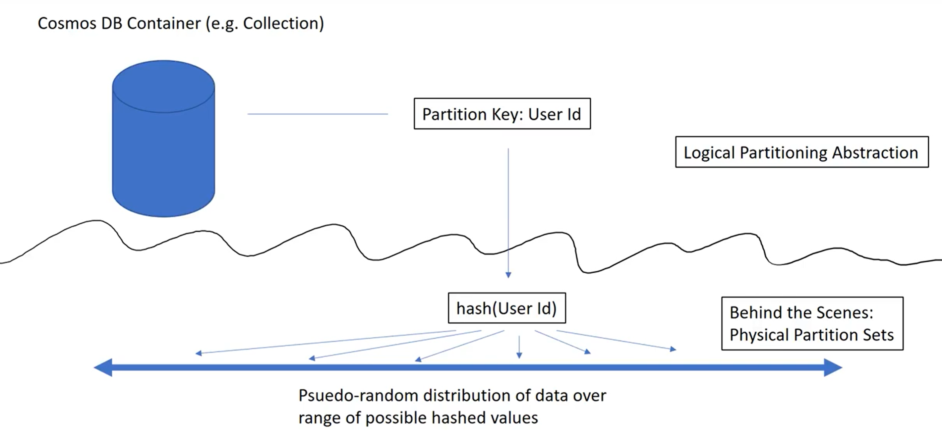
Consisted Hashing technique
Partition key is hashed
Transparent Load balancing across partitions
Key should not change over time
Synthetic key supported
https://docs.microsoft.com/en-us/azure/cosmos-db/partitioning-overview

Slide 16
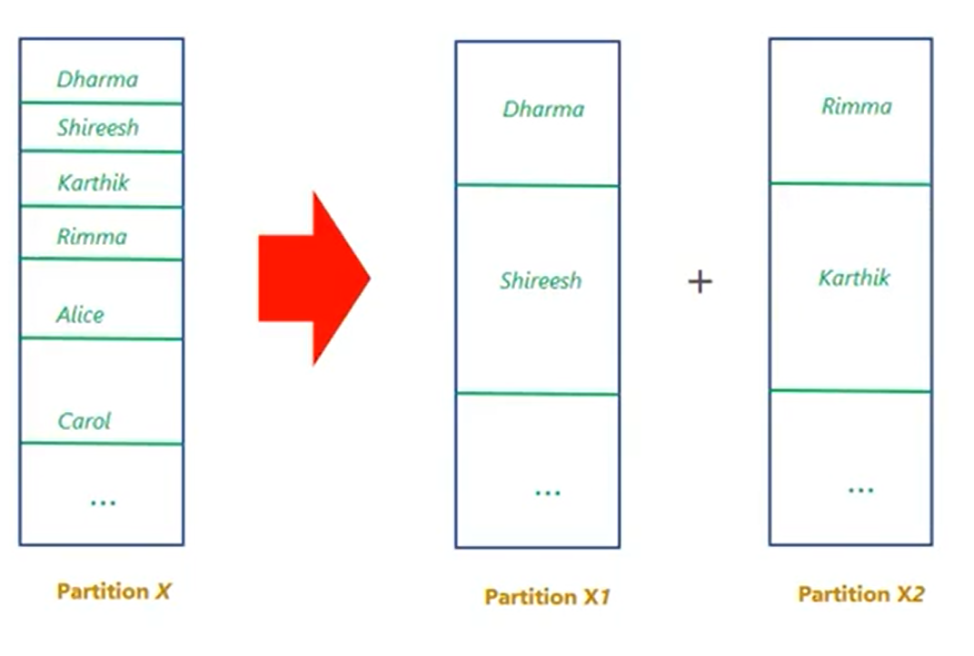
Reshuffling (rebalancing) of data What to do if partition needs to grow?
Continuous monitoring for RUs and Storage
If RU > max(RU) => N = RU/max(RU)
If storage > max(storage) => split in 2 partitions
No split if Key reach 10GB! Logical partition cannot be split. All key values must remain in it.
CosmosDB takes care of 99%
You take care of 1% => You take care of partition key
https://docs.microsoft.com/en-us/azure/cosmos-db/partition-data

Slide 17
Choosing Partition Key
Wide range of values
Even access pattern
Ideal partition key appears frequently in a query
Remember: Logical partition is max. 10GB

Slide 18
Good to know
Automatic partitioning is cool, but it might be dangerous.
For example: If you have different throughput inserting and reading you cannot use it. If inserting is with higher throughput than reading usually by default CosmosDB is expensive, the opposite case comes with throttling error.
You should/could manage throughput programmatically.

Slide 19
SQL API
Working with Document Database
Create Database
Create Collection
Insert Data
Query data
https://github.com/Azure/azure-cosmos-dotnet-v3

Slide 20
MongoDB API
Working with Mongo Database
Create Database
Create Collection
Insert Data
Query data

Slide 21
Graph Databases
Working with Mongo Database
Create Database
Create Collection
Insert Data
Query data

Slide 22
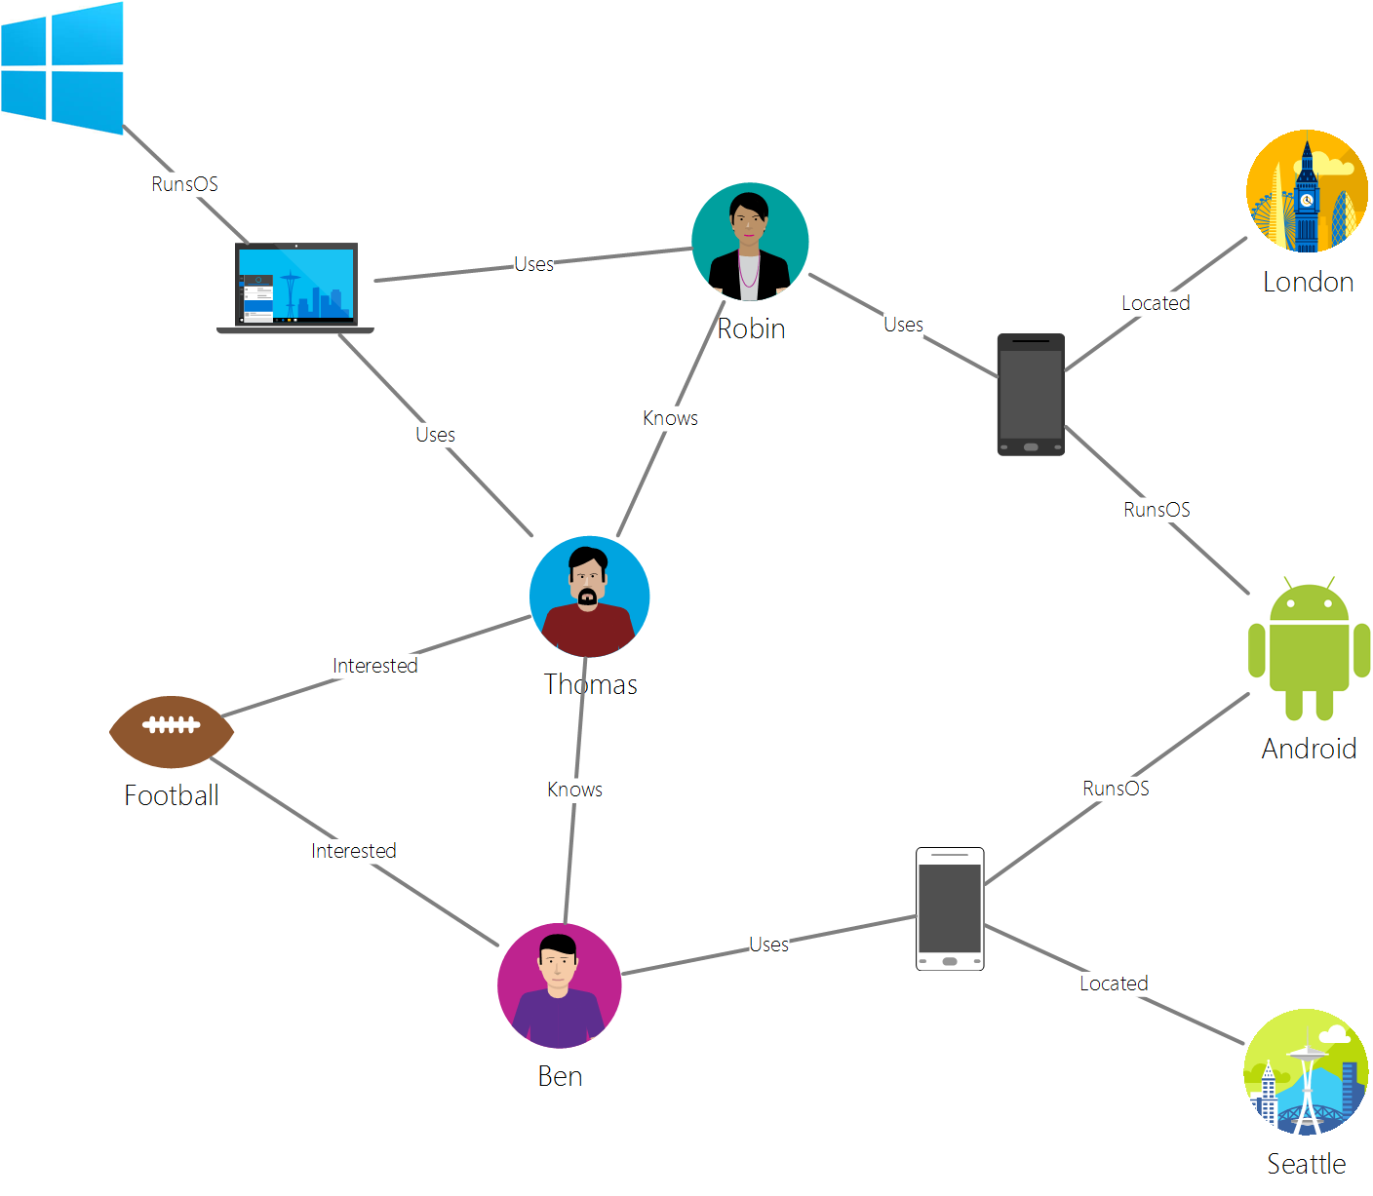
Graph
Structure composed of vertices and edges
Both have props (key/value pairs)
Edges defines relationships between vertices
Vertice
Edge

Slide 23
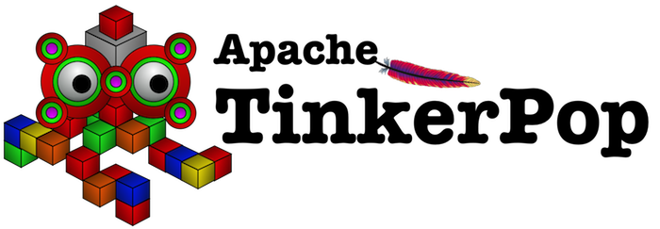
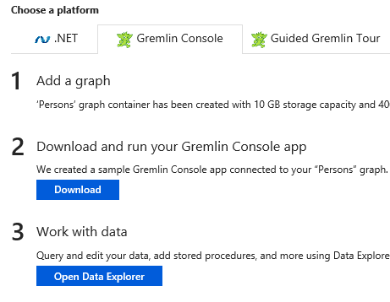
Tinkerpop and Gremlin
Tinkerpop is open source graph computing framework
Gremlin is graph traversal language
Gremlin Console
Tinkerpop: https://tinkerpop.apache.org/docs/current/reference/#gremlin-console
Quick Starts
https://docs.microsoft.com/en-us/azure/cosmos-db/create-graph-gremlin-console

Slide 24
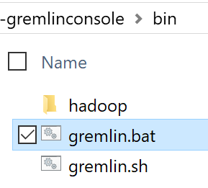
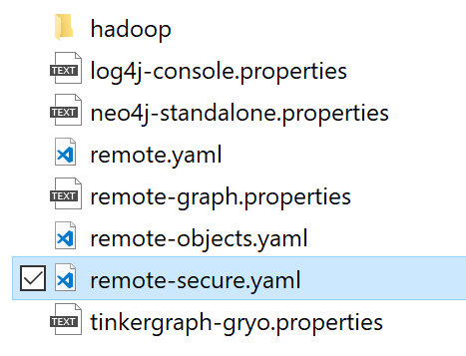
Gremlin Console
Run gremlin.bat to start console
Connect to Cosmos DB :> :remote connect tinkerpop.server conf/remote-secure.yaml
Redirect commands to server :remote console
hosts: [YOURDBNAME.gremlin.cosmosdb.azure.com]
port: 443
username: /dbs/graphdb/colls/YOURCOLLECTIONNAME
password: YOURPRIMARYKEY
connectionPool: {
enableSsl: true}
serializer: { className: org.apache.tinkerpop.gremlin.driver.ser.GraphSONMessageSerializerV1d0, config: { serializeResultToString: true }}

Slide 25
Add vertices
Label
Defines the type of element
:> g.addV('person‘) .property('firstName', 'Thomas‘) .property('lastName', 'Andersen‘) .property('age', 44) .property('userid', 1)
Id is generated automatically.
:> g.addV(‘‘device).property(‚‘deviceId', ‚D1‘)
Specify id explicitly
:> g.addV(‘‘device).property(‚‘deviceId', ‚D1‘).property(‘id‘, “Some String‘)
Notes:
g.addV('person').property('firstName', ‚Christin').property('lastName‘, ‚T').property('age', 44).property('userid', 1)

Slide 26
Lookup Vertices
List all persons
:> g.V().hasLabel('person')
List all persons with specified name.
Case Sensitive!
:> g.V().hasLabel('person‘).has(‘firstName‘, ‚Damir‘)
:> g.V().hasLabel('person‘).has(‘firstName‘, ‚Damir‘).values(‚id‘, ‚firstName‘)
Project only specified properties
:> g.V().hasLabel('person‘).has(‘id‘, ‚A001‘).property(‚age‘, 99)
Update some property
Notes:
g.V().hasLabel('person').has('firstName', 'Damir’)
V()

Slide 27
Add Edges
Lookup source vertices by id.
Add edge with semantic meaning
D001
:> g.V(). has(‚id‘, „P001“) .addE(‚ownsDevice‘) .property(‚fromYear‘,‘2018‘)
.to(g.V().has(‚id‘, „D001“))
Optionally, add some property
ownsDevice
Lookup destination verices
P001
Notes:
g.addV('person').property('firstName', 'Thomas').property('lastName', 'Andersen').property('age', 44).property('userid', 1)

Slide 28
Recap
SQL DBs (RDBMS) are great approved technology
NoSQL solve many problems easy way
Higher scale
No schema
Partitioning
No Down Time
Geo Distribution
Key-Value, Table, Document, Graph, SQL
Miltimodel: CosmosDb, DataStax
GraphDB with Gremlin API (native+.NET)

Slide 29
Thank YOU ☺
Damir Dobric
daenet Lead Software Architect Microsoft Regional Director Azure MVP
damir.dobric@daenet.com https://about.me/damirdobric

